Slide 1
Digital Systems Design
Processor Logic Design

Slide 2
Introduction
A computer CPU must manipulate not only data but also instruction codes and addresses coming from memory.
The register that holds and manipulates the operation code of instructions is considered to be part of the control unit.
Here, we will learn about the general-purpose register, commonly called an accumulator.

Slide 3
Processor Organization
In a well organized processor unit, the data paths are formed by means of buses and other common lines.
The control gates that formulate the given path are essentially multiplexers and decoders whose selection lines specify the required path.
All organizations employ a common ALU and shifter.
The differences in organizations are mostly manifested in the organization of the registers and their common path to the ALU.

Slide 4
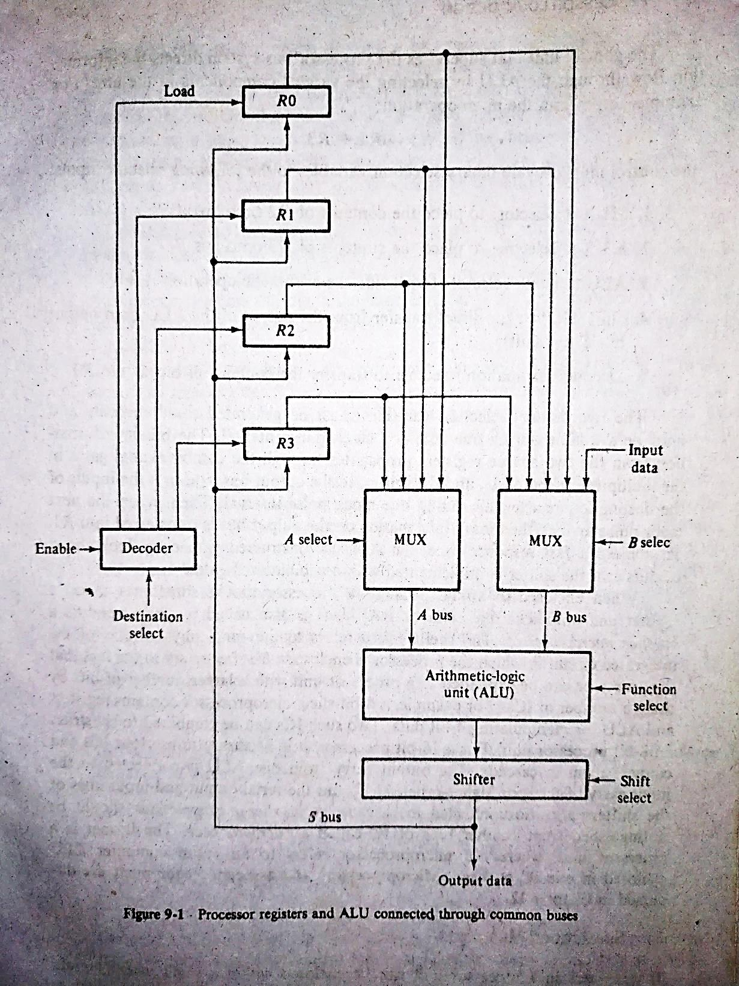
Bus Organization
When a large number of registers are included in a processor unit, it is most efficient to connect them through common buses or arrange them as a small memory having very fast access time.
In the figure, there are 4 processor registers. Each register is connected to 2 MUXs to form input buses A and B.
The result from the shifter goes through the output bus S into the inputs of all registers.

Slide 5
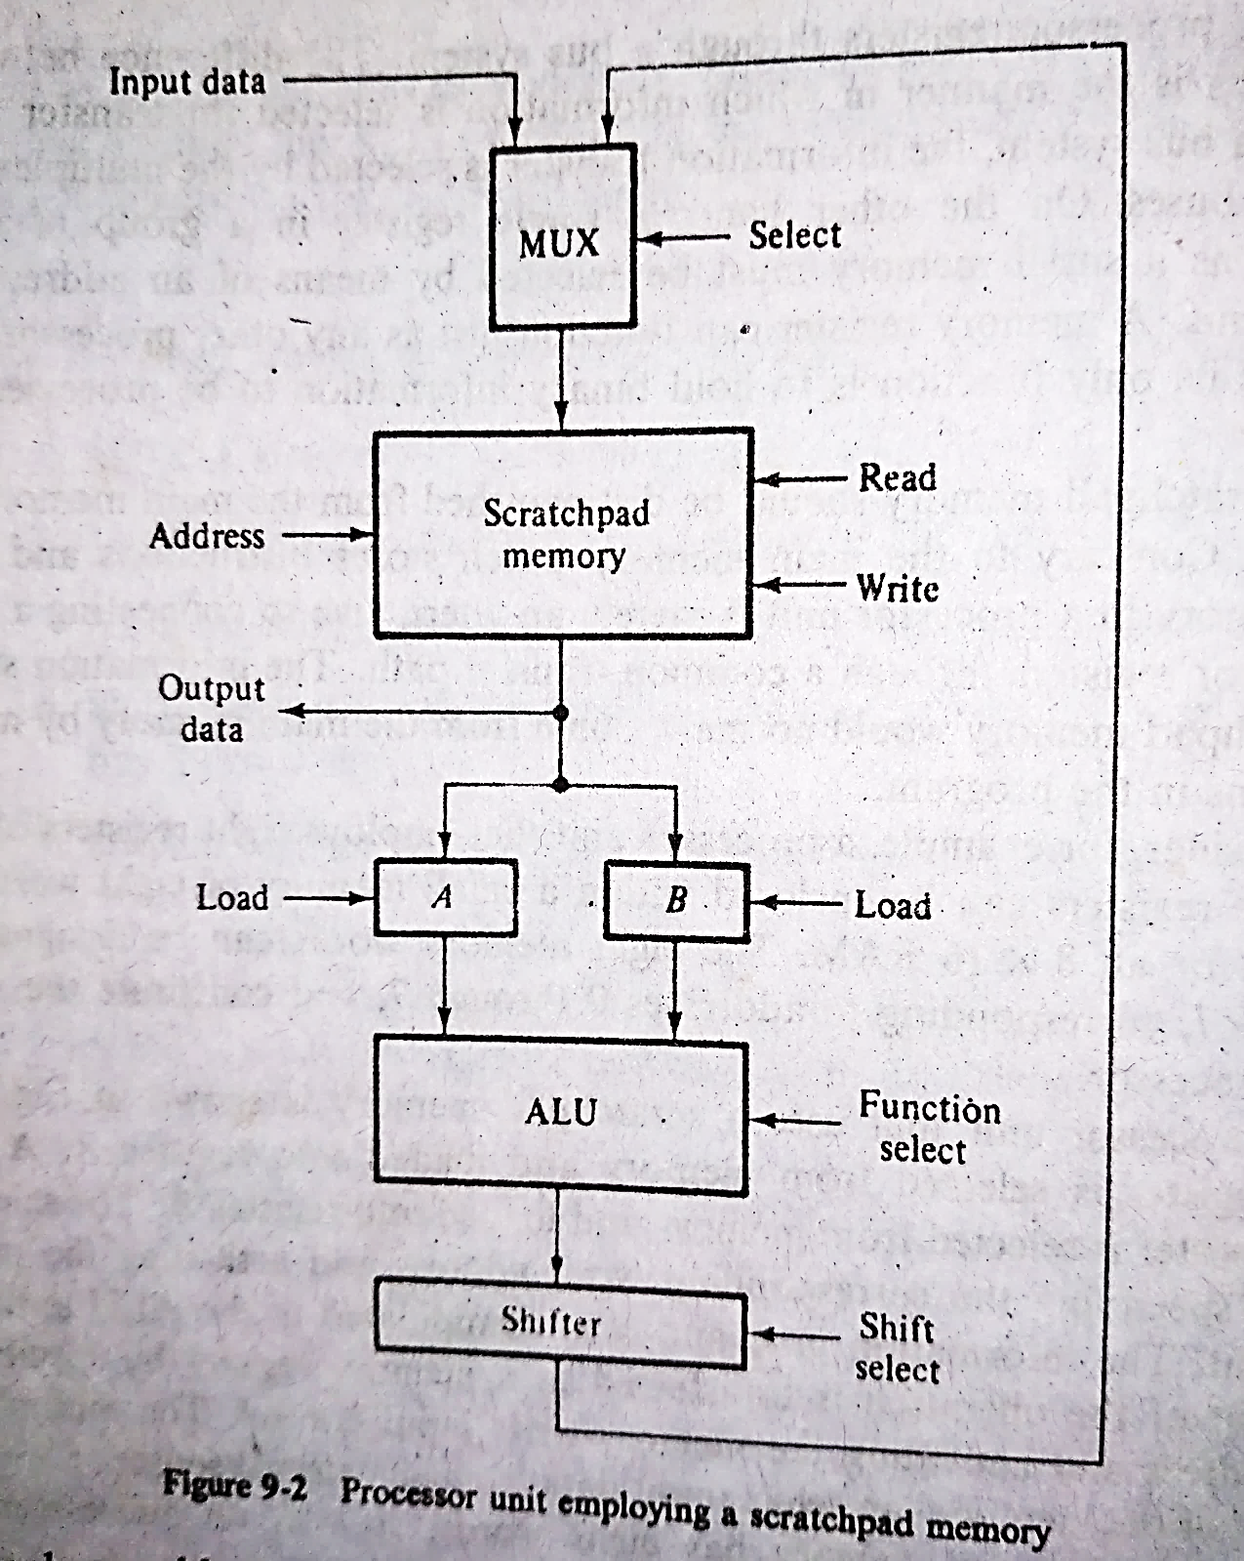
Scratchpad Memory
The registers in a processor unit can be enclosed within a small memory unit. This memory is called scratchpad memory.
For example, a processor unit employs 8 registers of 16 bits each. The 8 memory words can be designated R0 through R7.
A single register can be selected by means of an address to the memory unit.

Slide 6
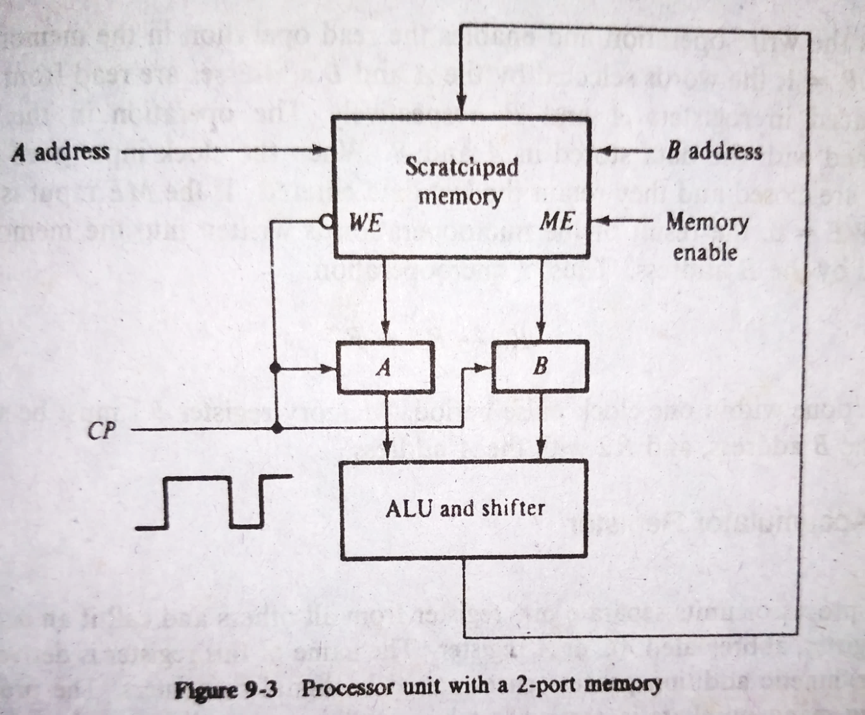
2-Port Memory
Some processors employ a 2-port memory in order to overcome the delay caused when reading 2 source registers.
When enabled by the memory enable (ME) input, new data can be written into the word specified by the B address.

Slide 7
Accumulator Register
Input data
Some processor units separate one register from all others and call it an accumulator register (AC or A register).
It is a multipurpose register capable of performing not only the add microoperation, but many other microoperations as well.
To form the sum of 2 numbers stored in processor unit, we need;
T₁: A←0
T₂: A ← A + R1
T₃: A ← A + R2
Select B source
Processor registers or Memory Unit
A
B
ALU
Accumulator
Register
Output data

Slide 8
Arithmetic Logic Unit
ALU can perform a set of basic arithmetic operations and a set of logic operations.
It has a number of selection lines to select a particular operation in the unit.
The selection lines are decoded within the ALU so that k selection variables can specify up to 2^{k} distinct operations.
A
B
s₂
Arithmetic Logic Unit
(ALU)
s₁
C_{out}
s₀
C_{in}
F

Slide 9
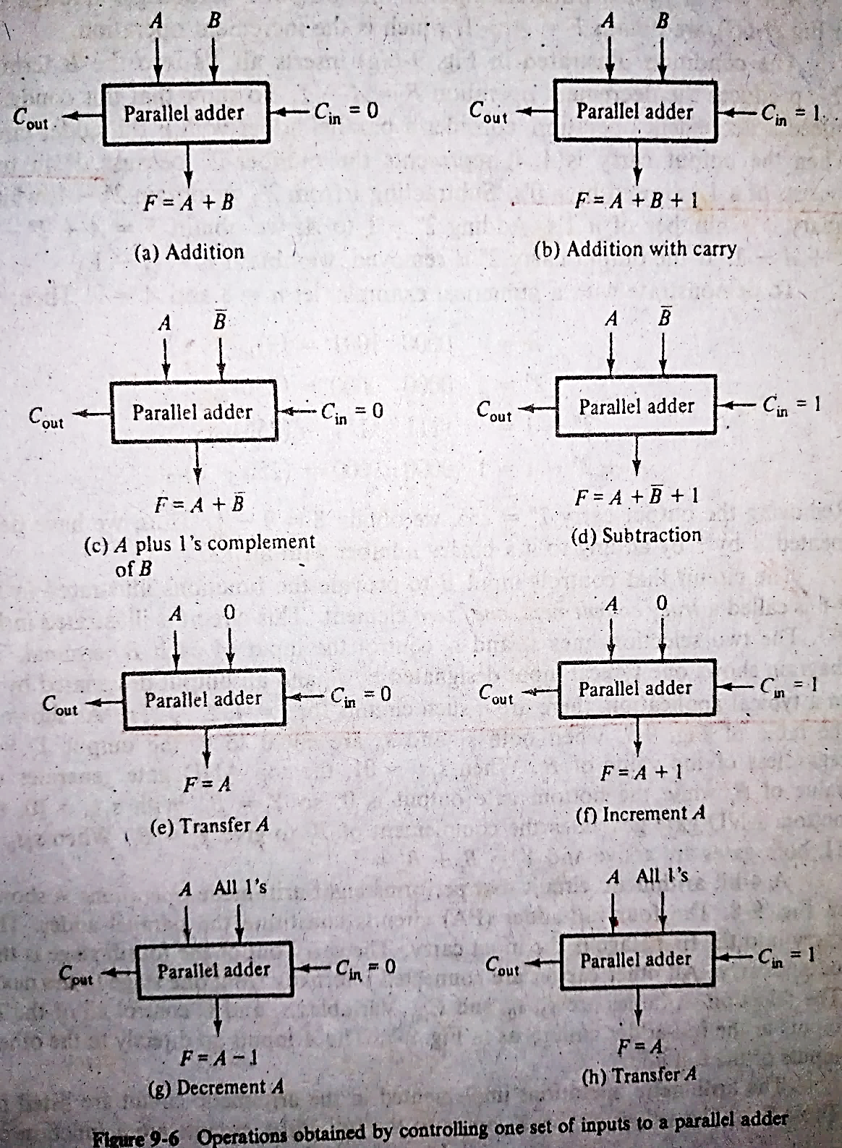
Design of Arithmetic Circuit
The basic component of the arithmetic section of an ALU is a parallel adder.
A parallel adder is constructed with a number of full-adder circuits connected in cascade.
The circuit that controls input B to provide the functions is called a true/complement, one/zero element.
S₁ | S₀ | Y_{i}
0 | 0 | 0
0 | 1 | B_{i}
1 | 0 | B_{i}’
1 | 1 | 1

Slide 10
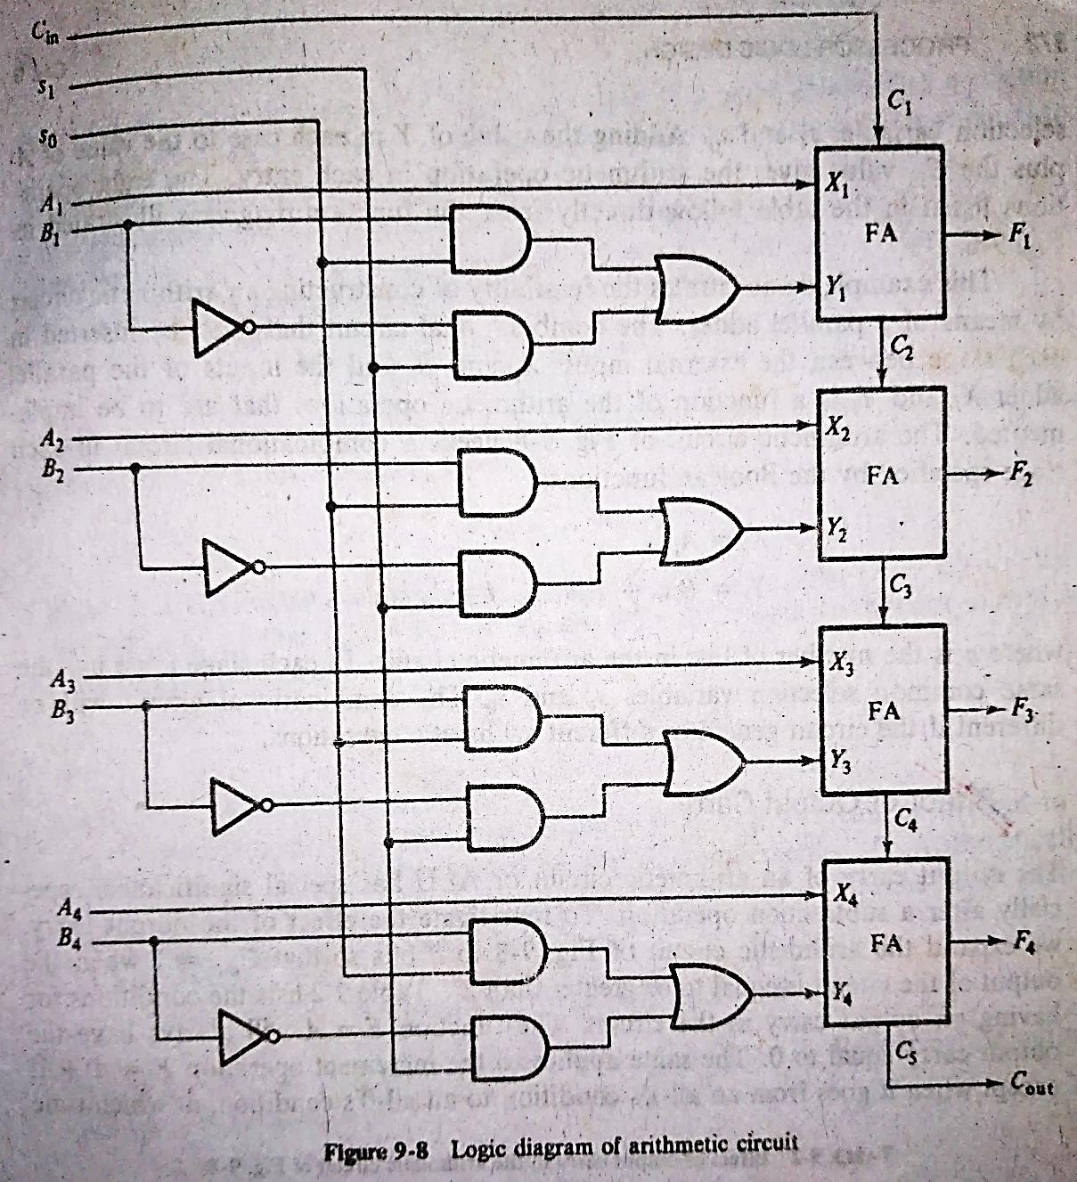
Design of Arithmetic Circuit
Function select |  |  | Y equals | Output equals
s₁ | s₀ | C_{in}
0 | 0 | 0 | 0 | F = A
0 | 0 | 1 | 0 | F = A + 1
0 | 1 | 0 | B | F = A + B
0 | 1 | 1 | B | F = A + B + 1
1 | 0 | 0 | B’ | F = A + B’
1 | 0 | 1 | B’ | F = A + B’ + 1
1 | 1 | 0 | All 1’s | F = A – 1
1 | 1 | 1 | All 1’s | F = A

Slide 11
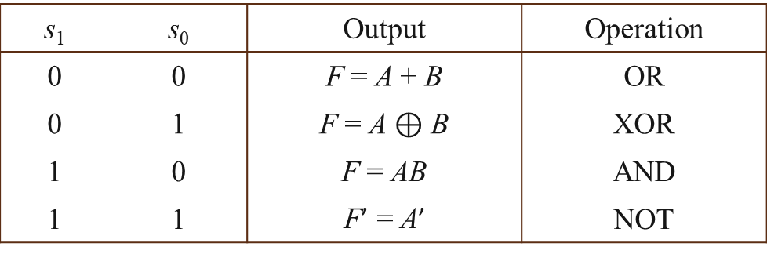
Design of Logic Circuit
s₁ | s₀ | Output | Operation
0 | 0 | F = A + B | OR
0 | 1 | F = A $⊕$ B | XOR
1 | 0 | F = AB | AND
1 | 1 | F’ = A’ | NOT

Slide 12
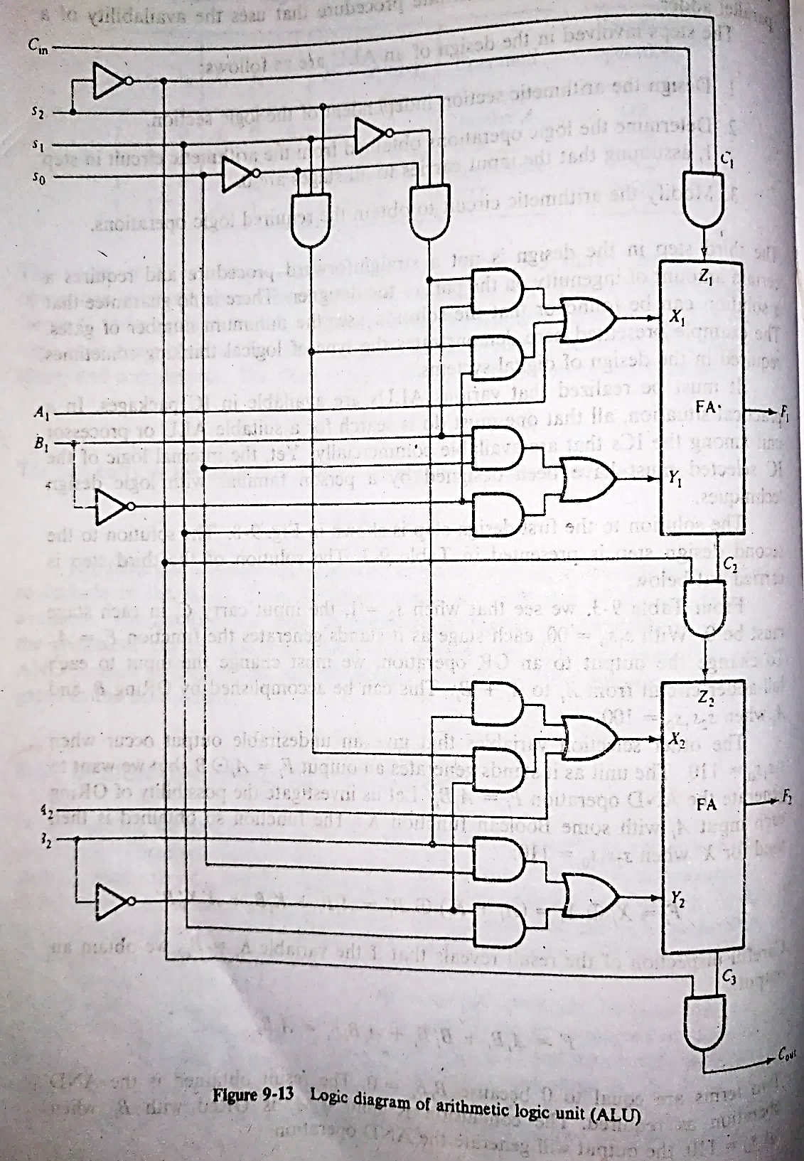
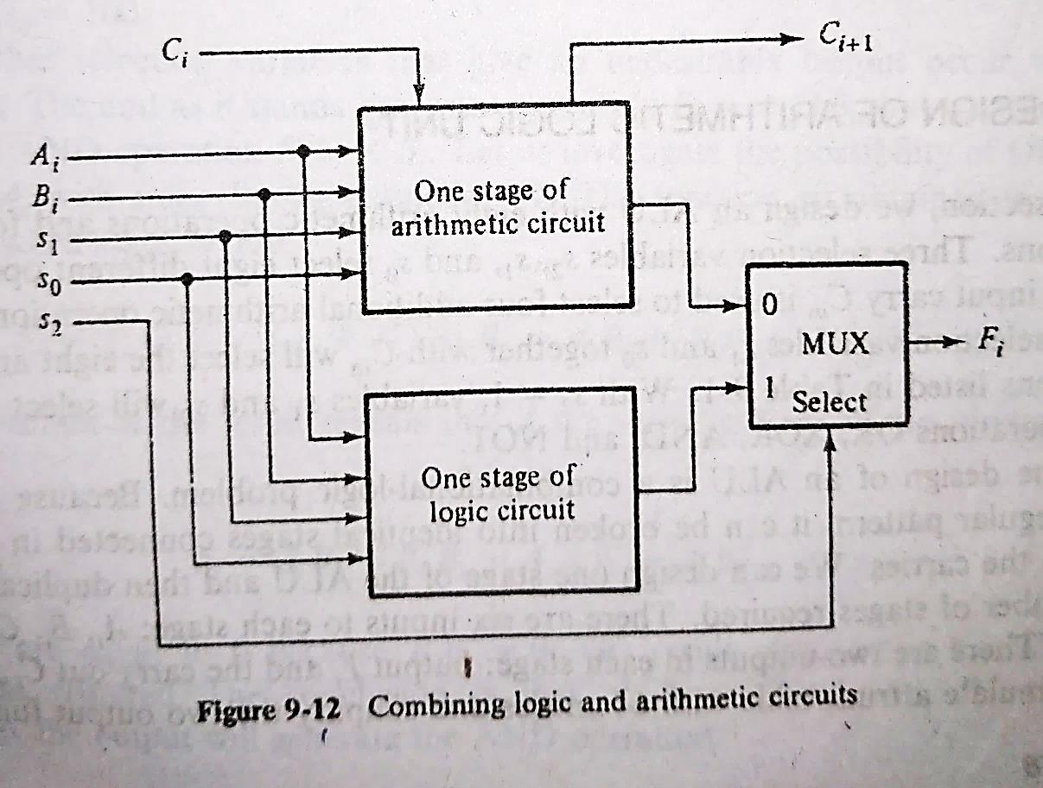
Design of Arithmetic Logic Unit
To combine the two unit we need another selection line s₂.

Slide 13
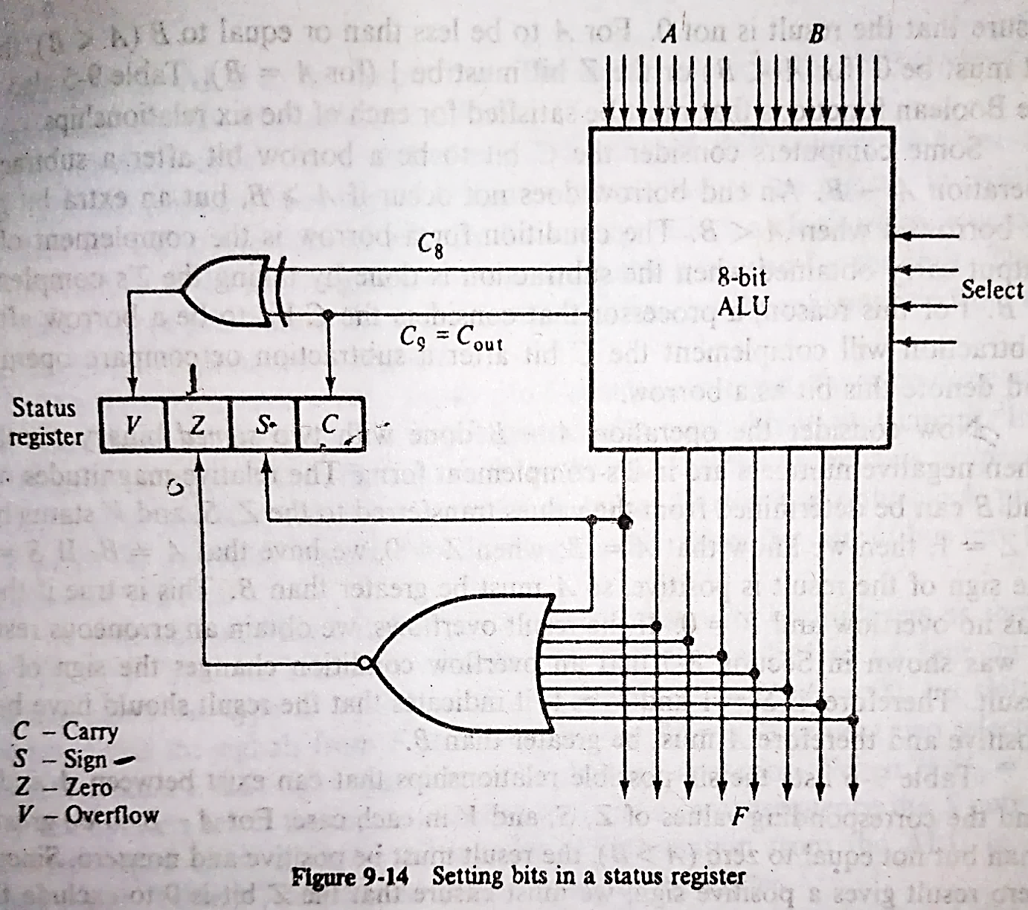
Status Register
It is sometimes convenient to supplement the ALU with a status register where these status-bit conditions are stored for further analysis.
Status-bit conditions are sometimes called condition-code bits or flag bits.

Slide 14
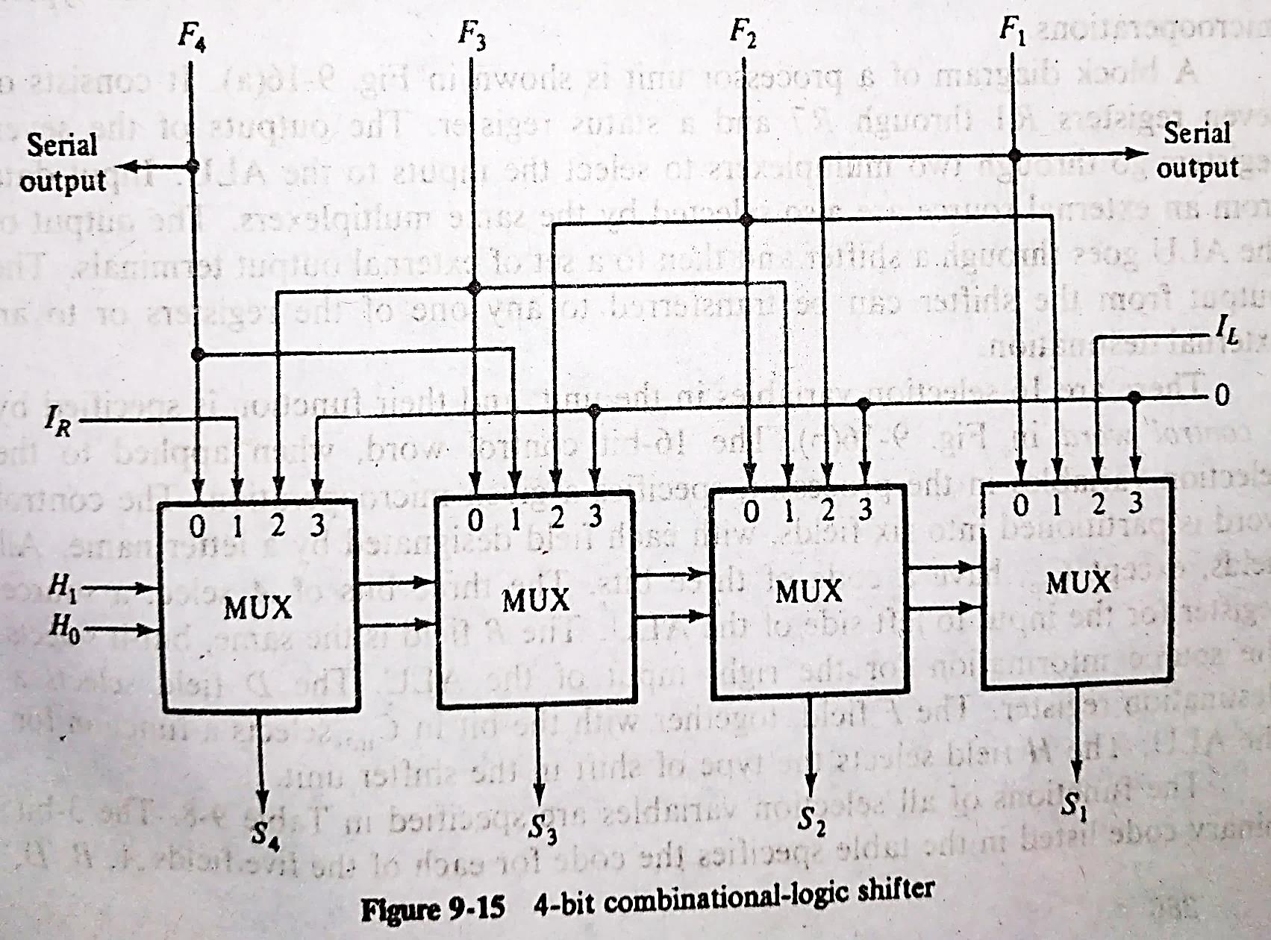
Design of Shifter
The shifter may transfer the information directly without a shift, or it may shift the information to the right or to the left.
H₂ may be employed to specify I_{R} or I_{L} during shift.
H₁ | H₀ | Operation
0 | 0 | No shift
0 | 1 | Shift right
1 | 0 | Shift left
1 | 1 | Assign zero

Slide 15
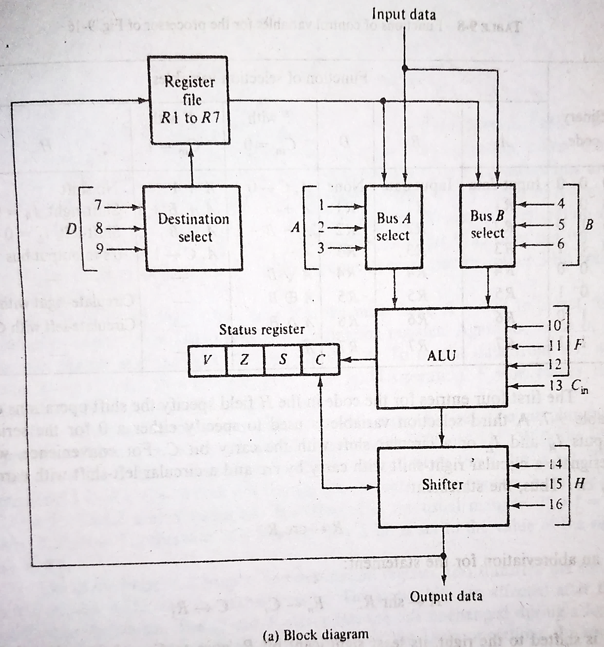
Processor Unit
1..3 4..6 7..9 10..12 13 14..16
Control word
A | B | D | F | C_{in} | H
The selection variables in a processor unit control the microoperations executed within the processor during any given clock pulse.
16 selection variables in the unit and their functions are specified by a control word.
The control word is partitioned into 6 fields with each field designated by a letter name.

Slide 16
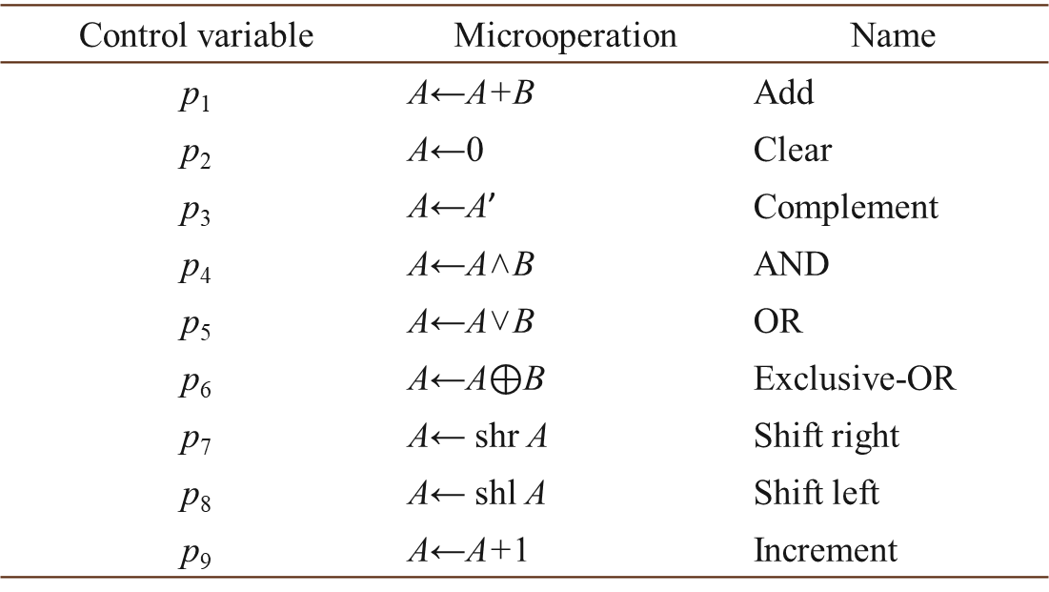
Design of Accumulator
An accumulator is a sequential circuit with A register and the associated combinational circuit. It requires control variables p₁ through p₉ generated by control logic circuits.
Register A
Control variable | Microoperation | Name
p₁ | A←A+B | Add
p₂ | A←0 | Clear
p₃ | A←A’ | Complement
p₄ | A←A˄B | AND
p₅ | A←A˅B | OR
p₆ | A←A$⊕$B | Exclusive-OR
p₇ | A← shr A | Shift right
p₈ | A← shl A | Shift left
p₉ | A←A+1 | Increment
Combinational Circuit
Control variables
B
Data inputs

Slide 17
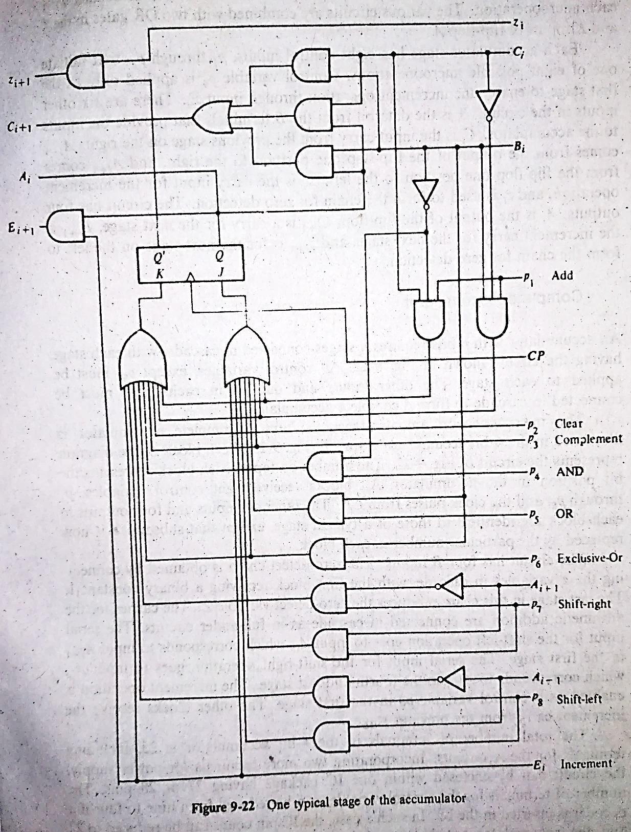
One Stage of Accumulator
The register we are using here is of JK-type flip-flops.
We must ensure that only one control variable is enabled at any given time.

Slide 18
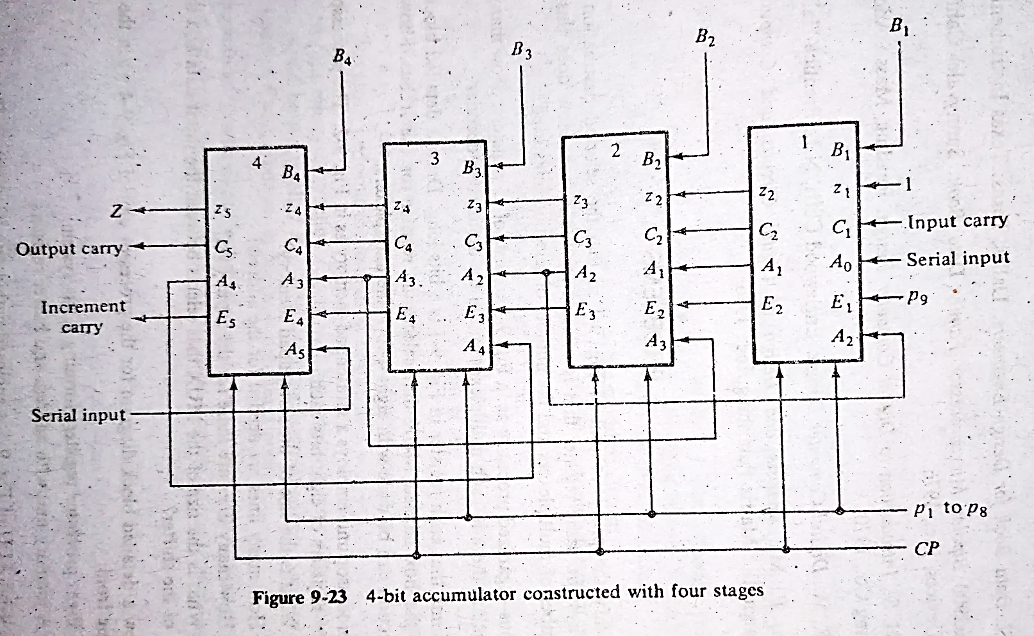
Complete Accumulator
Finally an accumulator with n bits requires n stages connected in cascade, with each stage having the circuit in the figure.

